Slide 1


Multi Class Animal Recognition
Muneera
STU655859dd6fb0f1700288989

Slide 2

Learning Objectives
Learned how to train a deep learning model to recognize different animal images using a pre-trained MobileNetV2 model.
Understood how to prepare and clean image data, including resizing and augmenting images to help the model learn better.
Worked with a large dataset of 90 different animal classes and learned how to manage and organize them.
Gained experience using TensorFlow and Keras to build, train, and evaluate the model.
Learned how to use a GPU for faster training and how to limit memory usage for smoother performance.
Understood how to check how well the model is performing using accuracy scores and classification reports.
Practiced visualizing data and results, such as showing example animal images and model predictions.
Improved Python programming skills, especially with machine learning and image processing libraries.
Learned how to deal with many classes (multi-class classification) and how to make the model recognize each animal correctly.
GOAL
Source :
https://github.com/MohammadMuneera/Multi_Animal_Class_Recognition

Slide 3
Tools and Technology used
Programming Language: Python – Used to write and run the entire code for data processing, model building, training, and evaluation.
Frameworks & Libraries: TensorFlow – Used as the main deep learning framework for building and training the model. Keras – High-level API within TensorFlow used for simplifying model creation and training.
Matplotlib & NumPy – For visualizing data and performing array operations .
Scikit-learn – For evaluating the model using tools like classification reports.
Predefined (Pretrained) Model : MobileNetV2 – A lightweight and efficient convolutional neural network used with transfer learning to classify 90 animal types.
Development Environment : Google Colab – A cloud-based notebook environment that allows free access to GPUs for faster model training and testing.
Dataset Used : https://www.kaggle.com/datasets/iamsouravbanerjee/animal-image-dataset-90-different-animals/data– A dataset containing images of 90 different animal classes used for training and evaluating the model.

Slide 4
Methodology
Data Collection : Collected a dataset containing images of various animals (90 different classes).The dataset was sourced from Kaggle, and it served as the foundation for training the model.
Data Processing : Resized and normalized the images to a uniform size and format . Applied data augmentation techniques (like rotation, flipping, zooming) using ImageDataGenerator to improve model generalization .
Model Selection : Chose a pretrained model, MobileNetV2, because it’s lightweight, fast, and well-suited for image classification tasks . Modified the top layers to fit the number of classes (90 in your case).
Training the Model : Trained the customized MobileNetV2 on the processed dataset using TensorFlow/Keras.Used GPU support via Google Colab to speed up the training process .
Evaluation of the Model : Evaluated the model's performance using metrics like accuracy and classification report.Also visualized model predictions to see how well it performs on new animal images.
Testing : Finally, tested the model on unseen data to ensure it can correctly classify animals it has never seen before . The testing phase confirmed how effective and reliable the model is in real-world use.

Slide 5
Problem Statement:
In recent times, many wild animals are disappearing because of problems like forest destruction, illegal hunting, and changes in the climate. The usual ways of tracking and watching these animals take a lot of time and effort, and they don’t always give fast results.
To solve this, we need smart technology that can automatically watch over animals and help protect them. This project, called Multi-Class Animal Recognition using Deep Learning, uses artificial intelligence to identify different animals from images.
It uses a special model called MobileNetV2, which is good at recognizing pictures. This system can help forest officers, researchers, and animal protection teams keep an eye on animals without needing to do everything by hand.
The main aim is to support wildlife surveillance, make animal tracking easier, and take quick action to save endangered animals before they disappear forever.
In wildlife sanctuaries like Kaziranga National Park in India, camera traps are widely used to monitor endangered animals such as the Indian rhinoceros. However, reviewing thousands of images manually to detect specific animals is a slow process. By using a deep learning model to automatically identify animals in real-time from these camera feeds, forest officials can quickly detect the presence of endangered species or intruders, helping them take timely action to prevent poaching and ensure the safety of these animals .

Slide 6
Solution:
To overcome the challenges of traditional wildlife monitoring, an AI-based solution is proposed through this project: Multi-Class Animal Recognition using Deep Learning.
By using a powerful yet lightweight model called MobileNetV2, the system can automatically identify and classify images of animals across 90 different species with high accuracy.
The project is implemented in Google Colab , utilizing GPU support for faster training and real-time performance. With image preprocessing and data augmentation techniques, the system becomes robust even with varied lighting, angles, and image quality.
This solution allows forest departments and conservationists to monitor wildlife through automated camera trap images or surveillance footage, reducing the need for manual labor and enabling quicker response to threats like poaching or endangered animal sightings.
Ultimately, this smart monitoring system provides a cost-effective, fast, and scalable tool for wildlife protection and helps in preventing the extinction of vulnerable species.

Slide 7
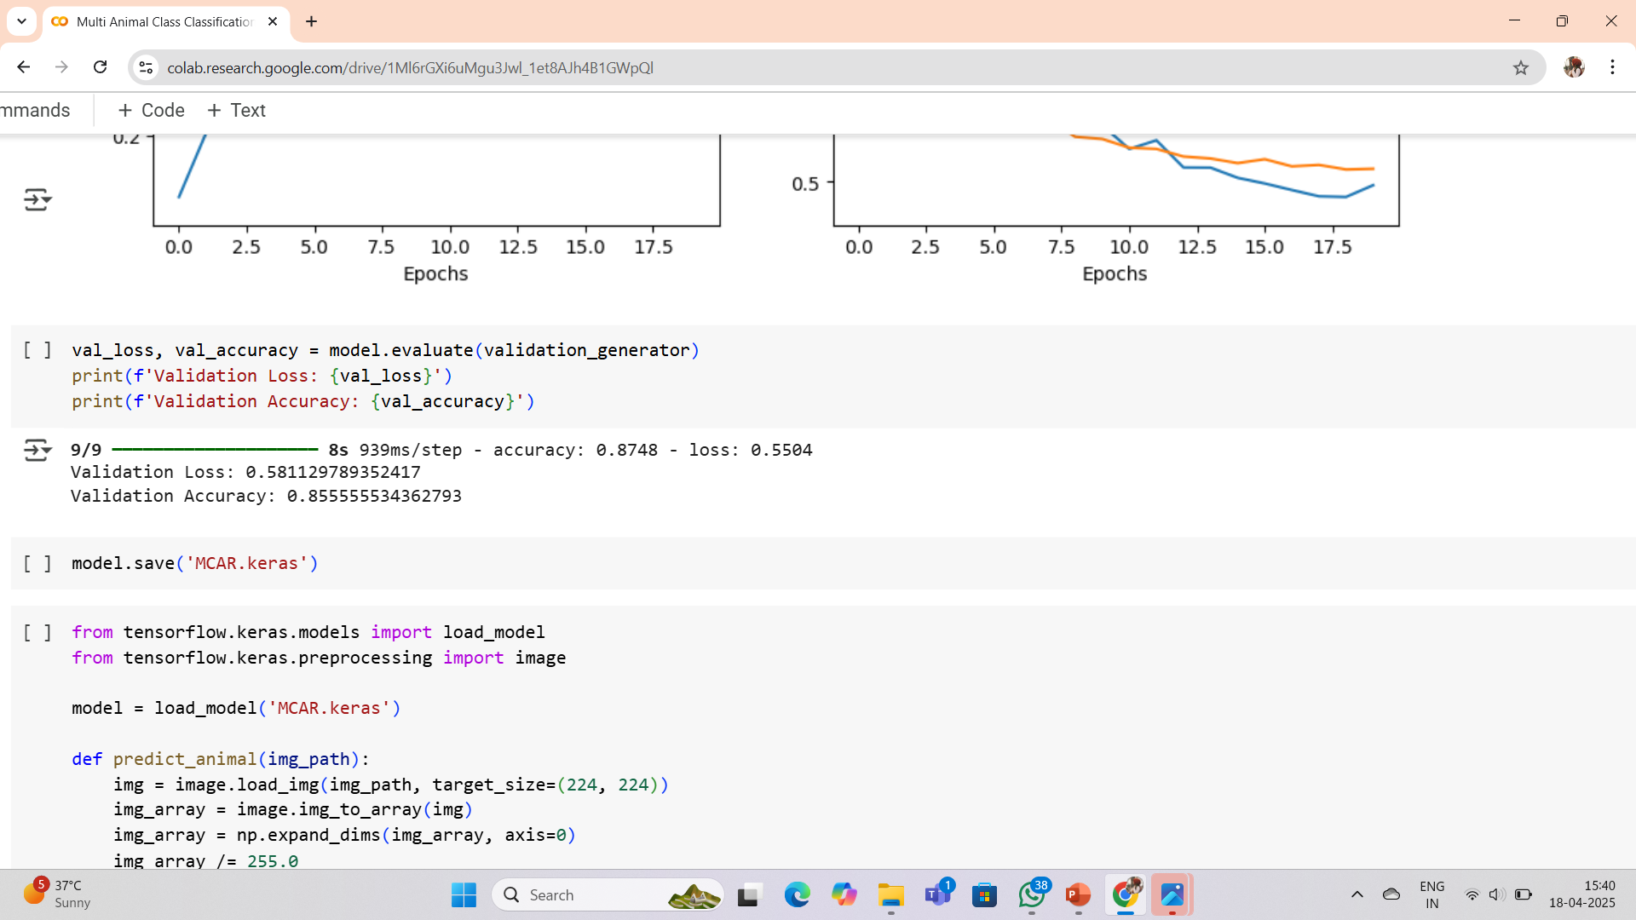
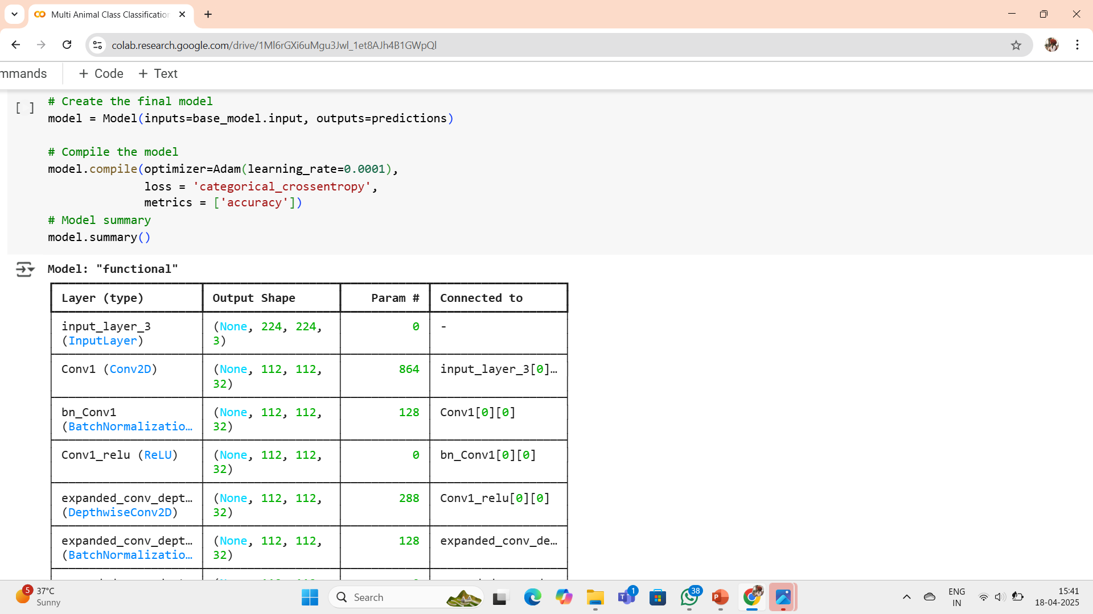
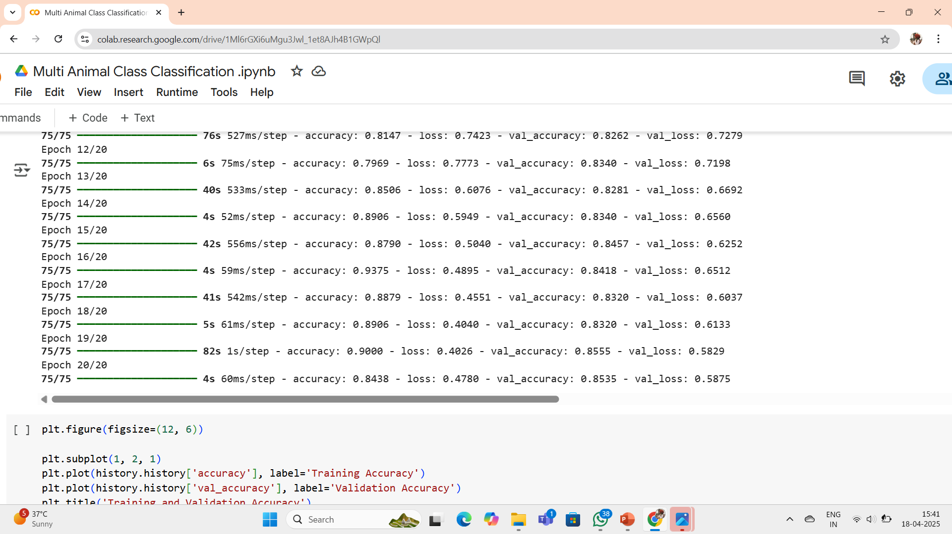
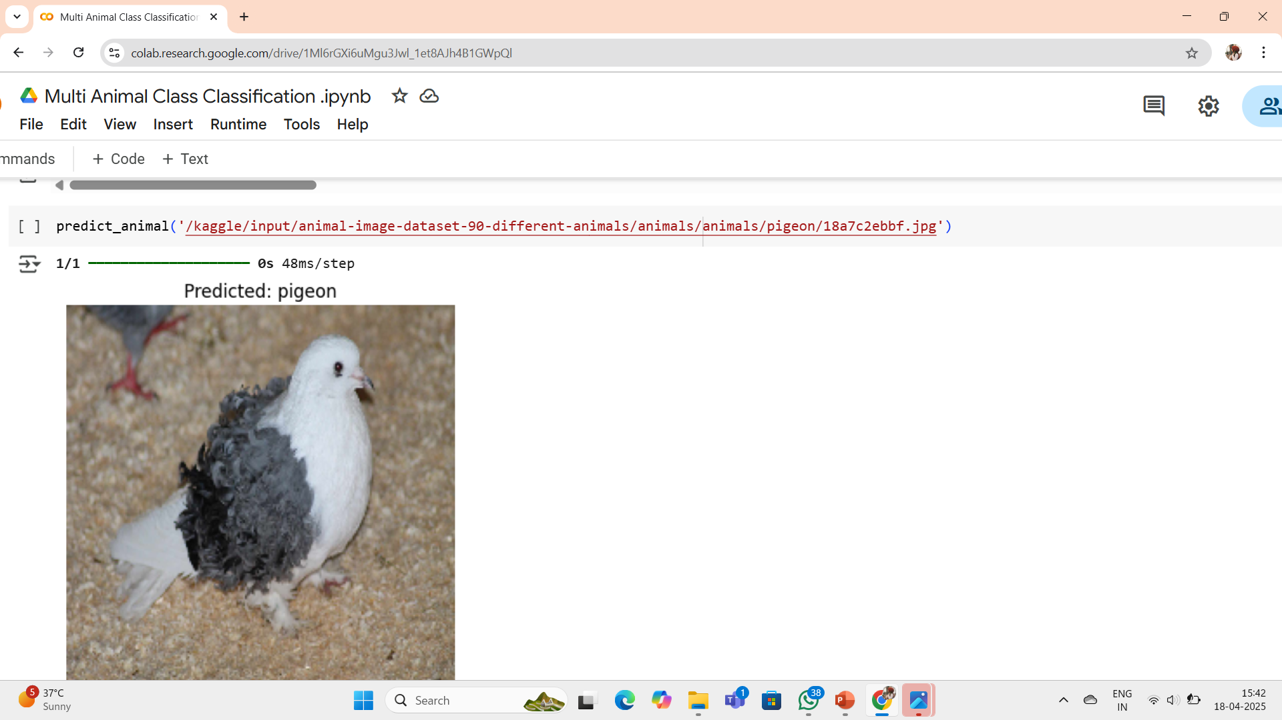
Screenshot of Output:

Slide 8
Conclusion:
The proposed model achieved a commendable accuracy of 85.5% by leveraging the MobileNetV2 architecture with pre-trained weights.
The high accuracy highlights the model's effectiveness in handling a large number of classes efficiently.
This approach demonstrates strong potential for real-time usage and practical deployment in various domains.
Future enhancements may focus on improving object recognition accuracy in real-time by optimizing for early-stage object detection, especially for complex scenes involving leaves, fruits, or tree-level features .
Further work can also explore context-aware learning, where the model considers 2 or more input configurations for enhanced performance and adaptability.
Github link : https://github.com/MohammadMuneera/Multi_Animal_Class_Recognition

